Slide 1
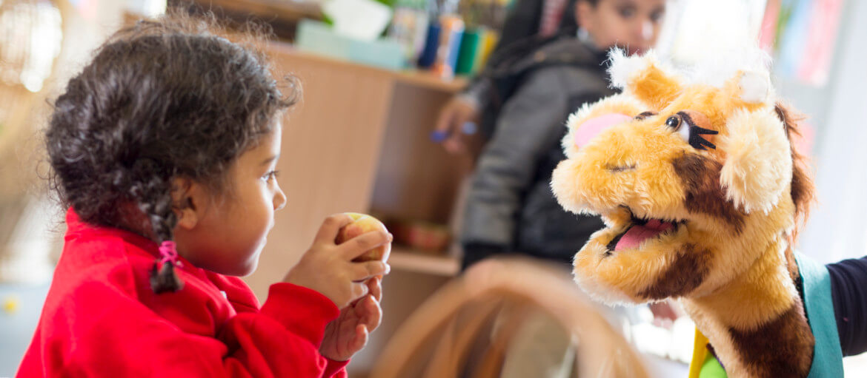


Supporting great
learning - every day

Slide 2



Coram SCARF is the leading UK provider of relationships, health, wellbeing, and drugs education.
Trained Educators use evidence-based, interactive, engaging methods and resources to provide memorable learning experiences for 1 in 10 children in England and Scotland.
What children experience
Children’s experience of Coram SCARF’s sessions is fun, engaging and memorable. Children meet Harold, our giraffe puppet mascot (‘Healthy Harold’). They have discussions and watch short films about healthy eating, legal and illegal drugs and their effects, the body and how it works, and friendships and their influence. They begin to understand the impact of their choices and behaviours on every aspect of their health and wellbeing - and learn the skills and information needed to make positive, informed health choices.
Harriet Gill

Slide 3
SCARF
Alongside the mobile classroom, Life Space or in-classroom visits, the online resource SCARF provides a curriculum and a whole-school framework for building the essential life skills to support physical and emotional wellbeing - crucial for children to achieve their best, academically and socially.
Meeting all DfE requirements for statutory Relationships, Sex and Health Education (RSHE), SCARF is a complete curriculum consisting of over 350 lesson plans and related assessments that gives teachers the skills and tools to teach a comprehensive RSHE, PSHE and Wellbeing programme throughout the primary years.
Harriet Gill

Slide 4
What will my child learn
in SCARF lessons?
For each year group, there are six suggested themed units which provide a complete PSHE and wellbeing curriculum. They are:
Me and My Relationships
Explores feelings and emotions, develops skills to manage conflict, helps identify our special people and equips children to recognise the qualities of healthy friendships and how to manage them.
Valuing Difference
Includes a strong focus on British Values, supports children to develop respectful relationships with others, recognise bullying, both online and in real life, respecting the rights of others, and know their responsibilities as a upstander.
Keeping Myself Safe
Covers a number of safety aspects from statutory Relationships Education including being able to identify trusted adults in their lives, positive ways to interact online, what to do when faced with a dilemma and recognising appropriate and inappropriate touch.

Slide 5
Rights and Responsibilities
Explores broader topics including looking after the environment, economic education and the changing rights and responsibilities children have as they grow older, alongside the need to respect the rights of others and to respect their environment.
Being My Best
Includes a focus on keeping physically healthy, developing a growth mindset to facilitate resiliency, setting goals and ways to achieve them.
Growing and Changing
Has age-appropriate plans to cover the physical and emotional changes that happen to children as they grow older, including changes at puberty and how to approach this with confidence. Age-appropriate lessons on relationships and sex education are also included.

Slide 6
Relationships & Sex Education
Relationships Education in primary schools should teach the fundamental building blocks and characteristics of positive relationships.
Coram SCARF believe that children should learn about relationships as well as the emotional, social and physical aspects of growing up, human sexuality and sexual health in an age-appropriate way, the majority of which is covered in Health Education and National Curriculum Science. Therefore, we often refer to this subject as RSE: Relationships and Sex Education.
The SCARF Relationships and Sex Education resources help children and young people to be safe, healthy and happy, both as they grow, and in their future lives. These lessons help to meet safeguarding, and emotional wellbeing requirements, as well as ensuring that schools cover the requirements of the DfE RSHE guidance.

Slide 7
Department for Education (DfE) statutory requirements for Relationships and Health Education (2025)
From September 2026, schools will be required to teach the 2025 revised guidance for Relationships and Health Education. The DfE also strongly encourages primary schools to deliver sex education in years 5 and/or 6 to help prepare children for their transition to secondary school.
This updated guidance gives a stronger focus on developing skills, as well as knowledge, particularly in navigating a complex, digital world safely and healthily. The guidance recognises there isn’t a one-size-fits-all approach, and that flexibility will help schools to meet the needs of their pupils best.
Some key updates include:
  Online Safety & AI: Expanded focus on AI literacy, deepfakes, sextortion, and online scams.
  Misogyny and Relationships: Explicit requirements to tackle misogyny, incel culture, and harmful pornography.
  Personal Safety: Includes comprehensive, practical safety training, including road, rail, and water safety.
  Health & Body: Enhanced coverage of menstruation, menopause, and gynecological health, plus correct anatomical terms for body parts in primary school.
  LGBTQ+ Inclusion: LGBTQ+ content must be integrated, and schools must comply with equality laws regarding gender reassignment.
This will go some way to supporting children to develop positive relationships, including skills for navigating boundaries with kindness and respect, to put in the early preventative work to tackle sexual violence and abusive behaviour.
Schools continue to be bound by the statutory guidance from 2019, and will have until September 2026 to adapt their curricula to reflect this new guidance. They can start following it from September this year if they wish to.

Slide 8
Why is it so important?
Research shows that not delivering this vital education puts our children at greater risk of poor mental health. We know this because every year, around 25% of girls start their periods before learning about them at school. This can result in them agonising over why they are bleeding and how serious the cause might be.
Similarly, 38% of boys experience wet dreams before having learnt about them, leaving them open to shame and stigma over a natural bodily function; this can lead to problems later in life. This updated guidance stipulates that puberty education including menstruation must start at eight years old to help children understand what to expect and avoid distress.
We also know that RSE has a protective factor when it comes to safeguarding children. 1 in 20 children are sexually abused and 1 in 3 of these do not report this to an adult. Sexual abuse can happen to any child; the best way to safeguard children is to ensure that they receive information on naming parts of their body, knowing the difference between appropriate and inappropriate touch, and having the skills and confidence to find and talk to a trusted adult to report any abuse.

Slide 9
Why is it so important?
Research now shows that children with better health (including mental health) and wellbeing are likely to achieve better academically. By learning about positive relationships, respect for themselves and others, and behaving appropriately and safely online, they are better able to enjoy their friendships and therefore focus more at school.
There is sometimes concern that RSE in school might promote sexual experimentation or cause confusion about an individual’s sexuality. Research on quality Relationships and Sex education in the UK by the National Survey of Sexual Attitudes and Lifestyles team consistently shows that men and women who reported that lessons at school were their main source of information about sex were more likely to have started having sex at a later age than those for whom parents or other sources were their main source.

Slide 10
Why is it so important?
https://www.coramscarf.org.uk/rshe-evidence

Slide 11
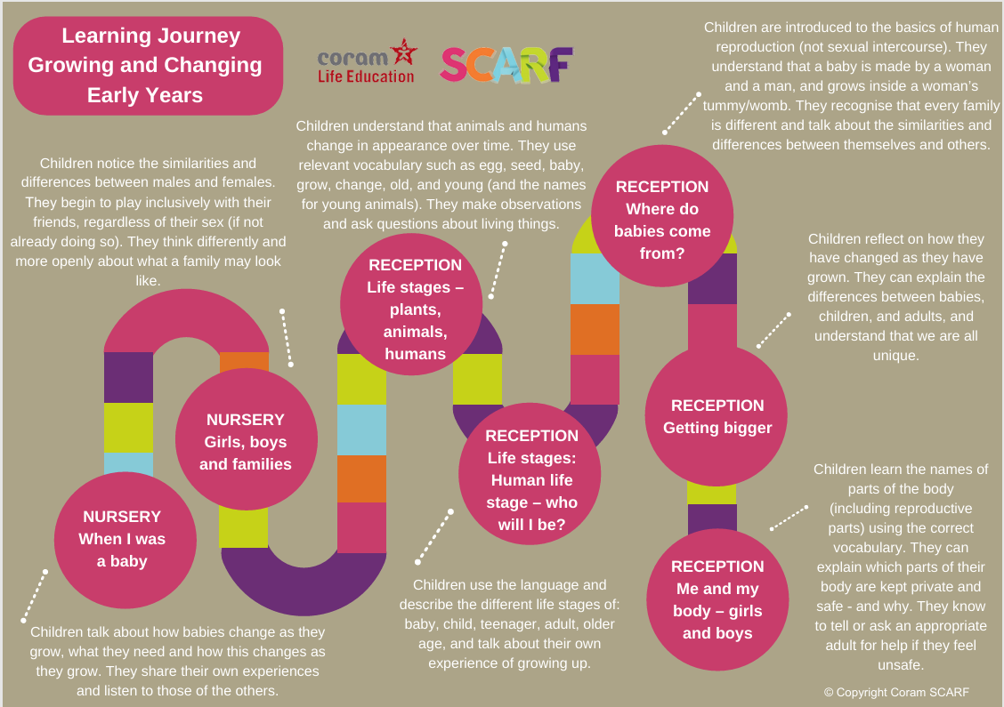



Slide 12
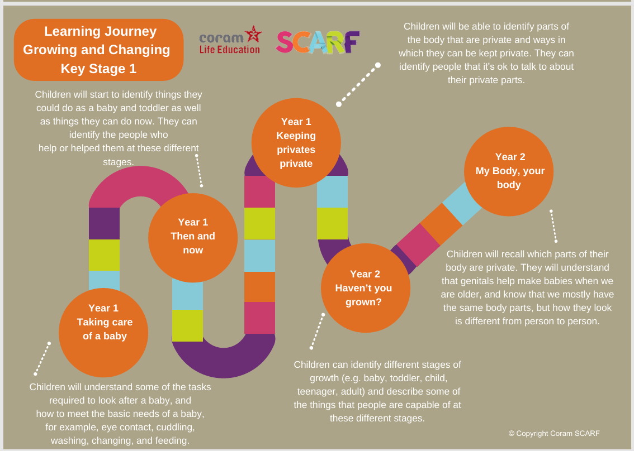


Slide 13
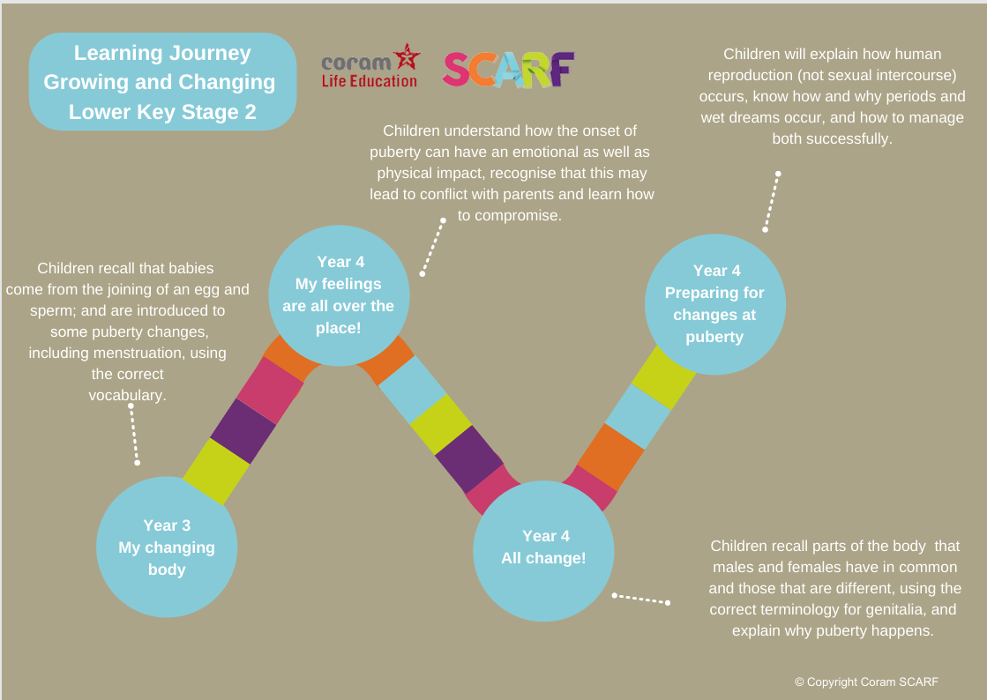

Slide 14
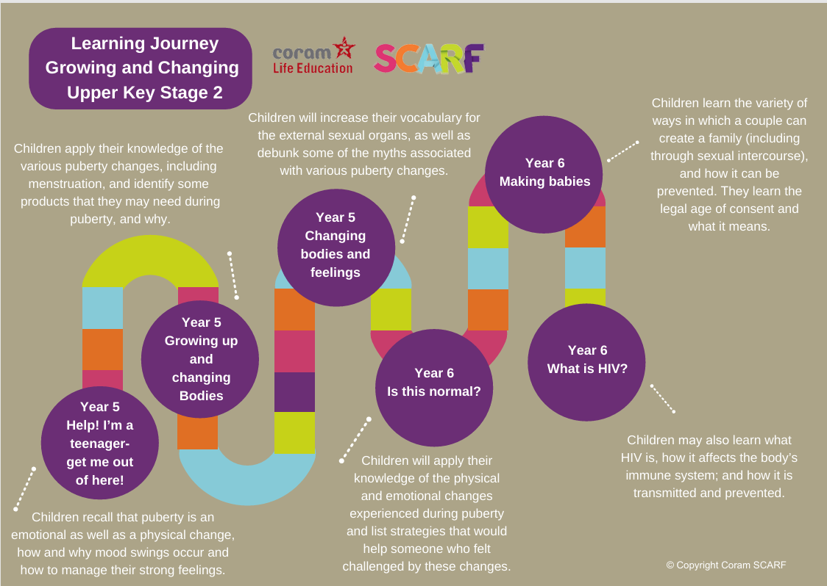

Slide 15
Reception Class content
Life stages in plants, animals and humans?
Where do babies come from?
Getting bigger
Me and my body
Looking after my special people
Looking after my friends
Keeping safe online
Sample Learning Activities
Role play how you can help your special people at home
Read a book together about getting bigger
Using the pairs cards, match up the baby animal with its adult equivalent
Draw pictures of a friend. At the bottom of the picture write how they look after that friend or how their friend looks after them.
Write some safety rules about being online

Slide 16
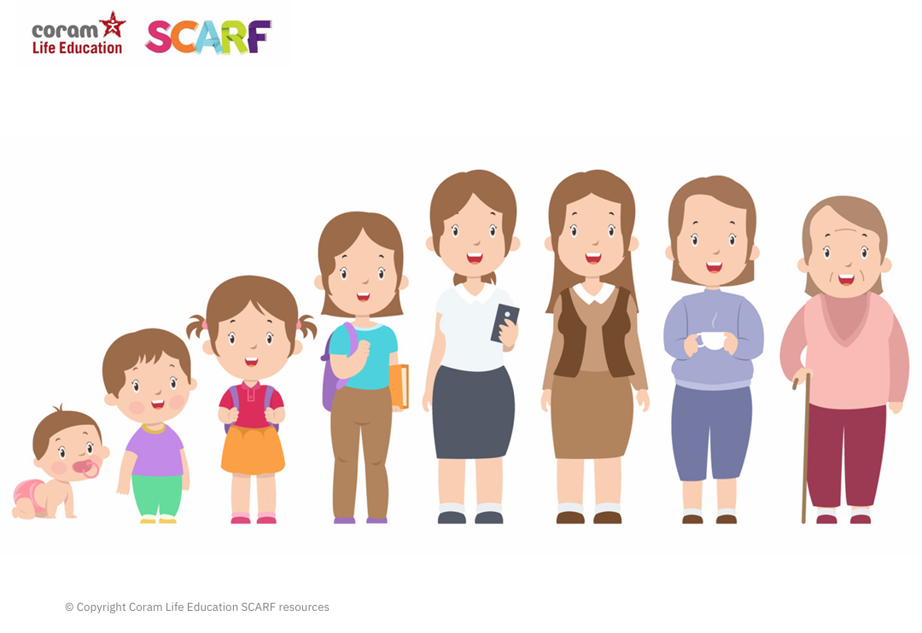

Slide 17
Year 1 content
Extending learning from Reception.
New content includes:
Our special people
Caring behaviour
Respecting others
Safe touch
Unsafe secrets
Friendship
Communication
Bullying (inc. online)
Boundaries
Privacy including naming the genitals
Feelings
Sample Learning Outcomes
Recognise and name some of the qualities that make a person special to them
Identify simple qualities of friendship
Identify things they could do as a baby, a toddler and can do now
Explain the difference between appropriate and inappropriate touch
Identify who they can talk to if they feel uncomfortable about any secret they are told, or told to keep
Identify parts of the body that are private

Slide 18
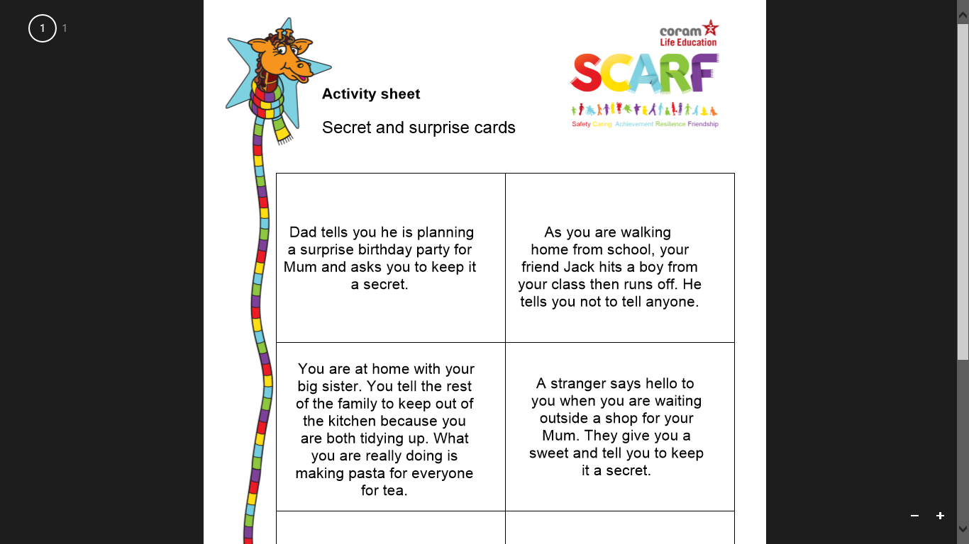

Slide 19
Year 2 content
Sample Learning Outcomes
Identify some of the ways that good friends care for each other, both online and in real life (IRL)
Know and use words and phrases that show respect for other people
Explain where someone could get help if they were being upset by someone else’s behaviour
Identify situations in which they would need to say 'Yes', 'No', 'I'll ask', or 'I'll tell', in relation to keeping themselves and others safe.
Identify the types of touch they like and do not like
Explain that our genitals help us make babies when we are older
Extending learning in year 1.
New content to include:
How my behaviour (positive or negative) affects others
Becoming more independent
Keeping myself and others safe
Growing from young to old and how people’s needs change

Slide 20
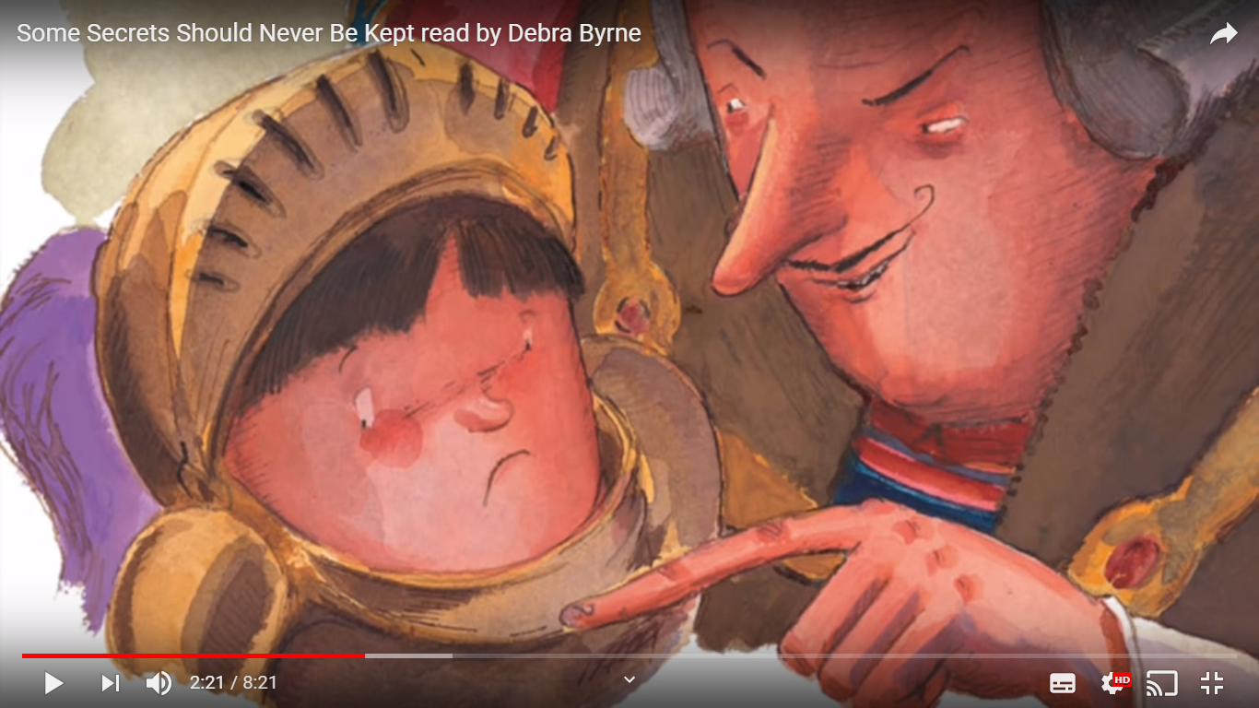
Notes:
https://youtu.be/4YjJ1MreZqs

Slide 21
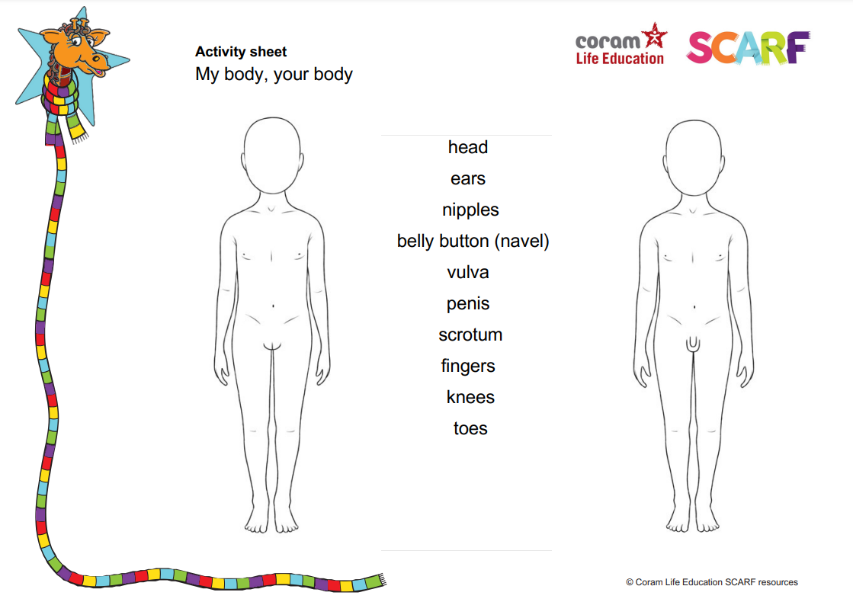

Slide 22
Year 3 content
Extending learning in year 2.
New content to include:
Change including bereavement
Images in the media
Protecting personal information online
Different types of relationships
Healthy and unhealthy relationships (friendships) both online and IRL
Discrimination and its consequences
Understanding risk
Making informed choices
Resisting pressure
Menstruation
Sample Learning Outcomes
Explain some of the feelings someone might have when they lose something important to them
Recognise and describe appropriate behaviour online as well as offline
Identify when it is appropriate or inappropriate to allow someone into their body space
Recognise who they have positive healthy relationships with
Recognise that repeated name calling is a form of bullying
Understand that for girls, periods are a normal part of puberty

Slide 23
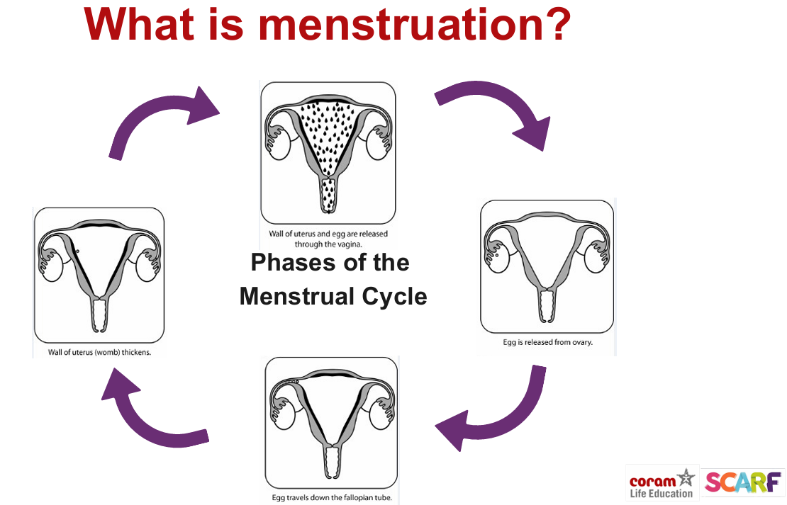
Notes:
Year 3

Slide 24
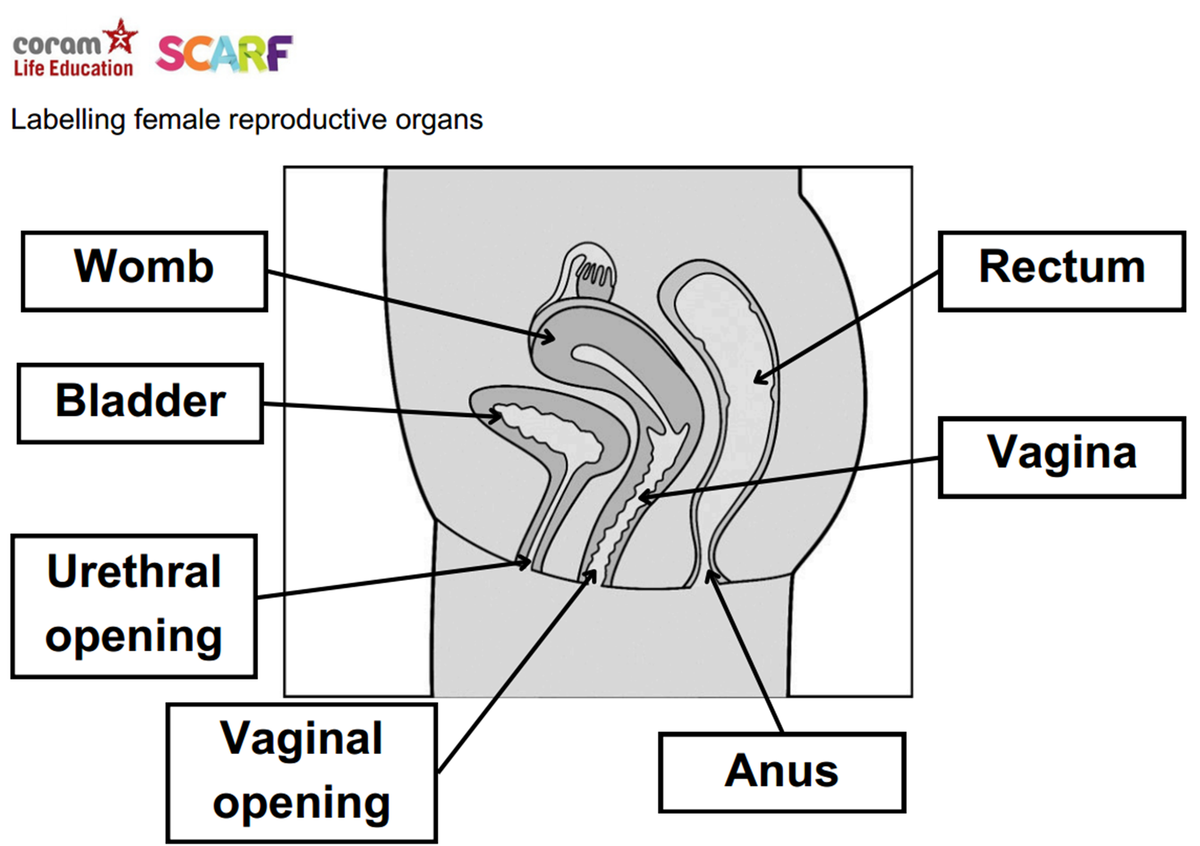

Slide 25
Year 4 content
Sample Learning Outcomes
Understand and explain why puberty happens
Suggest reasons why young people sometimes fall out with their parents
Discuss the reasons why a person would want to be married, or live together, or have a civil ceremony
Define what is meant by 'being responsible‘
Understand and identify stereotypes, including those promoted in the media
Understand that we can be influenced both positively and negatively
Extending learning in year 3
New content to include:
Body changes in puberty
Conflicting emotions
Good and not so good feelings
Marriage, Civil Partnership and other relationships
Consequences of our actions
Recognise and challenge stereotypes
Pressures to behave in an unacceptable, unhealthy or risky way

Slide 26
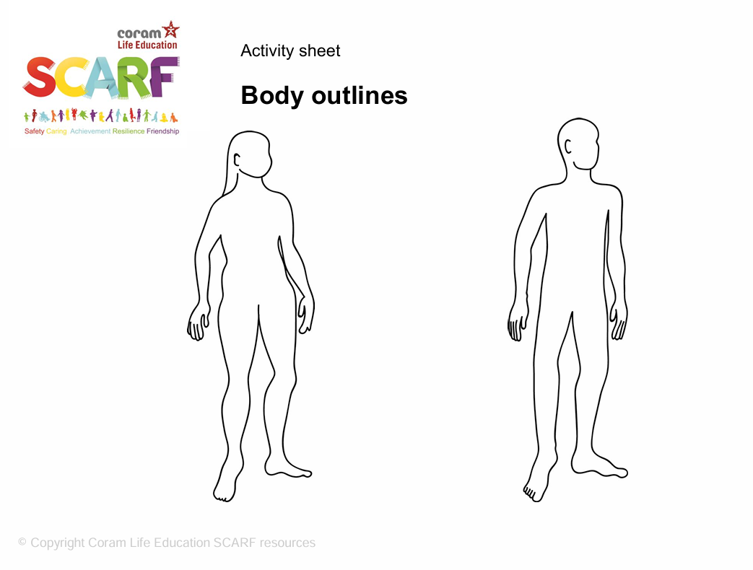
Notes:
Year 4

Slide 27
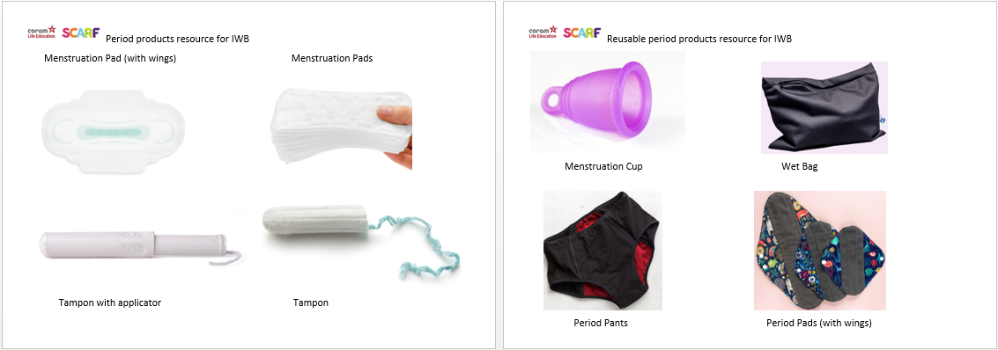

Slide 28
Year 5 content
Extending learning in year 4.
New content to include:
Body changes and feelings during puberty
Changing feelings and the effect on those we live with
Unhealthy relationships
Risky behaviour
Healthy behaviour online
Types of bullying including homophobic
Keeping personal information private online
Sample Learning Outcomes
Identify some products that they may need during puberty and why
Recognise some of the feelings associated with feeling excluded or ‘left out’
Identify what things make a relationship unhealthy
Explore and share their views about decision making when faced with a risky situation
Recognise that people aren’t always who they say they are online
Recognise that some people can get bullied because of the way they express their gender
Know how to protect personal information online

Slide 29
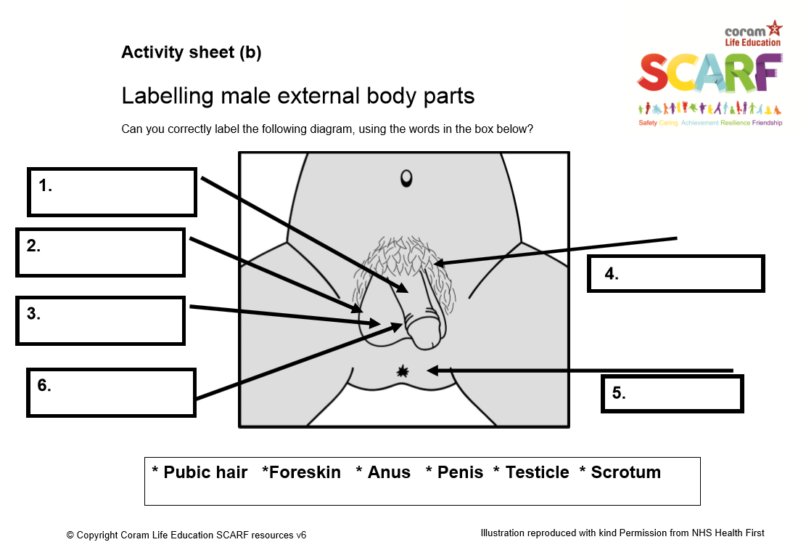
Notes:
Year 5

Slide 30
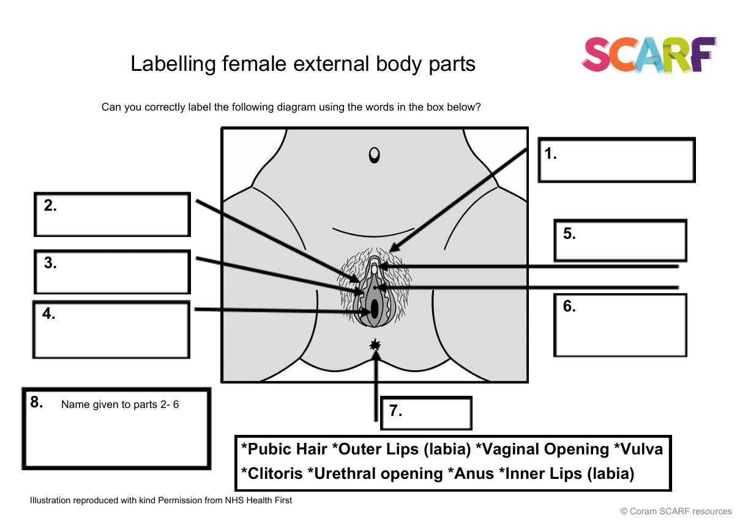

Slide 31
Year 6 content
Sample Learning Outcomes
Recognise that photos can be changed to match society's view of perfect
Explore the risks of sharing photos and films of themselves or others online, and without consent
Describe ways in which people show their commitment to each other
Know a variety of ways in which the sperm can fertilise the egg to create a baby
Extending learning in year 5.
New content to include:
Body image
Sharing images online
Forced marriage
Conception, reproduction & birth
Online sexual content

Slide 32
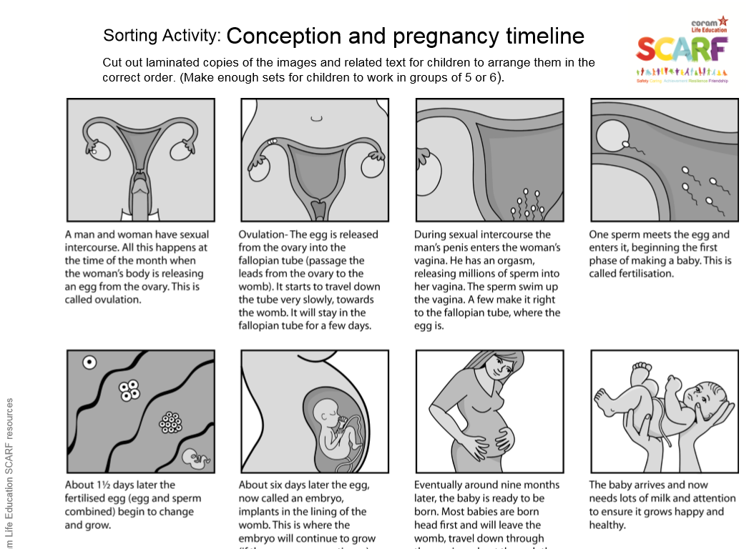
Notes:
Year 6

Slide 33
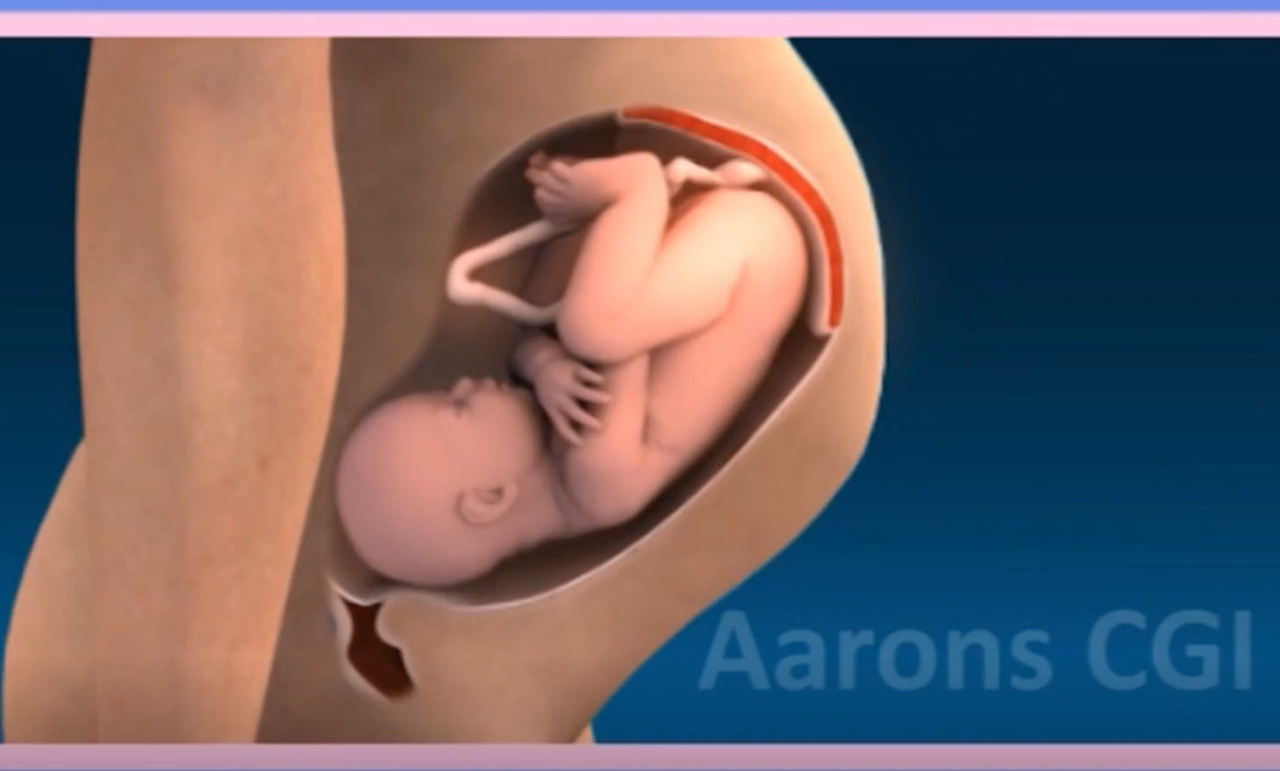
Notes:
https://www.coramlifeeducation.org.uk/scarf/lesson-plans/making-babies-1
Unable to add hyperlink as you will need to sign in to SCARF first

Slide 34
Right to withdraw
It’s compulsory for primary schools to teach Relationships Education and Health Education.
Parents do not have the right to withdraw their pupils from Relationships and Health Education, nor can they be withdrawn from topics taught as part of the science curriculum, including science topics related to puberty or sexual reproduction (Section 30).
Puberty is statutory under Health Education and has been strengthened in the 2025 guidance to include the correct names of body parts and to understand and express boundaries around these body parts. Puberty, as well as birth and reproduction, are also included in the national curriculum science (so there is no right to withdraw).
Whilst Sex Education is not compulsory in primary schools, the DfE recommends that primary schools teach Sex Education in years 5 and/or 6, in line with content about conception and birth, which forms part of the national curriculum for science.
We include non-statutory Sex Education in Year 6 (and Year 5 if required) to support schools in meeting their safeguarding duties.
Providing Sex Education lays the foundation for further learning in secondary school and helps pupils understand what sexual intercourse is, along with its potential consequences, such as pregnancy and viruses like HIV, and be clear what a healthy sexual relationship should look like.
This knowledge is an important part of enabling children to recognise and respond if anyone attempts to coerce them into sexual activity.

Slide 35
Right to withdraw
Parents have the right to withdraw their child from some or all of Sex Education delivered as part of statutory RSE.
It should be noted that there are three lessons in SCARF that include non-statutory Sex Education, to support schools to meet pupil needs, in line with the new guiding principles laid out in the revised RSHE statutory guidance.
These lessons are in Year 6:
  Making Babies
  What is HIV? (OPTIONAL)
  Online Sexual Content (OPTIONAL)
In the revised 2025 RSHE guidance, the DfE acknowledge that there may be a situation where the school knows that pupils have seen pornography, and which schools may feel the need to discuss online sexual content with those pupils. SCARF provides schools that have identified this need with an optional lesson to cover this content. Schools that plan to teach this lesson will inform parents of this decision and invite parents to view any relevant materials.

Slide 36

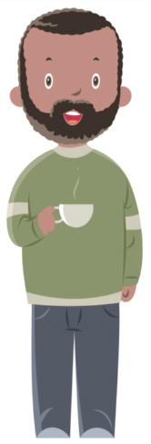

Our role as parents
DfE RSHE Statutory Guidance (2025)
Paragraph 31:
"Primary schools should... include offering parents support in talking to their children about sex education and how to link this with what is being taught in school ..."

Slide 37
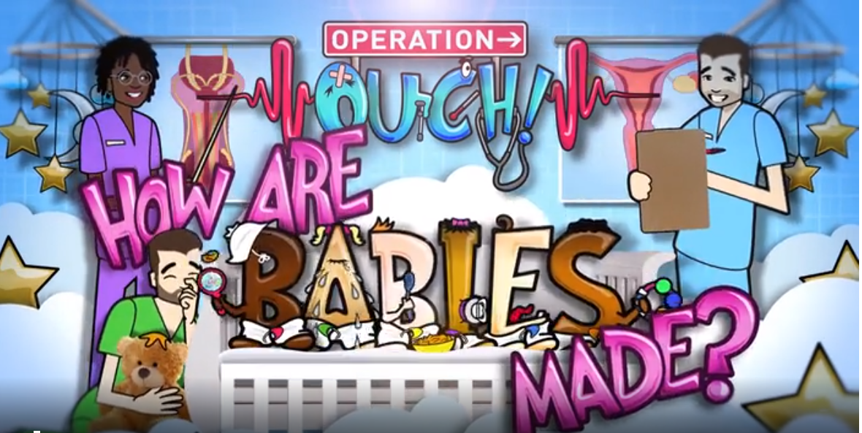
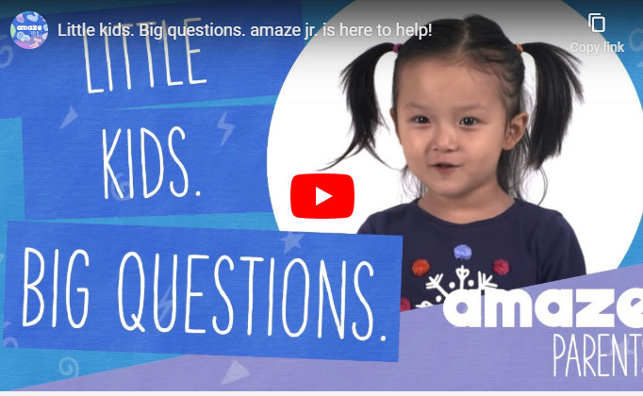
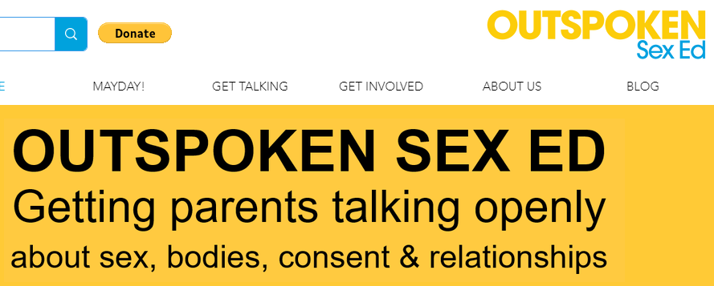
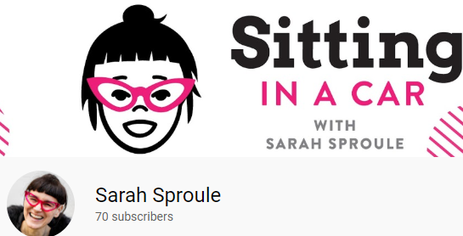
BBC Teach Operation Ouch
Amaze Junior
Sarah Sproule
Outspoken Sex Ed

